Slide 1
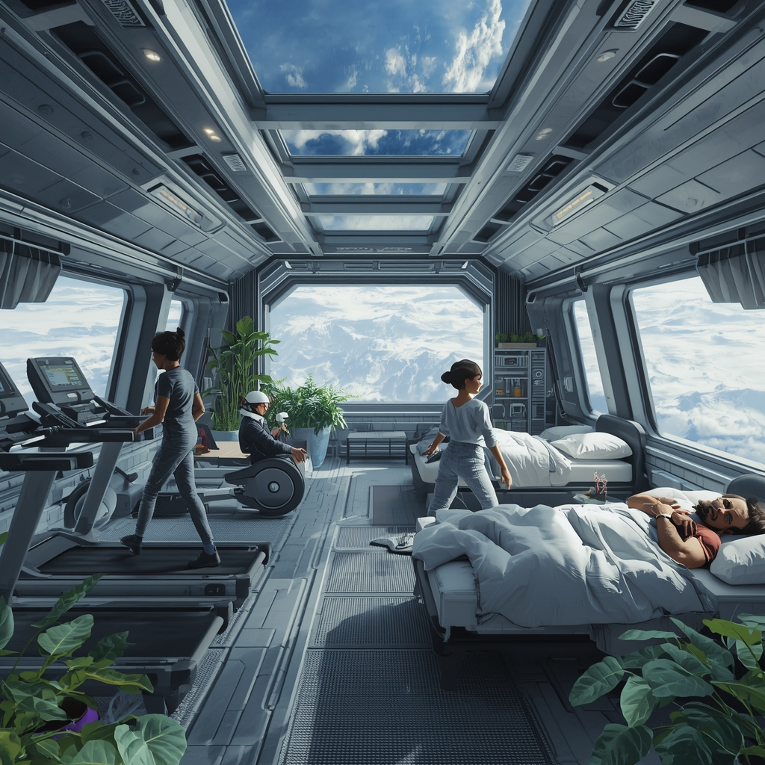



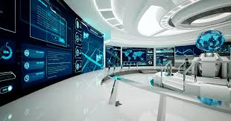


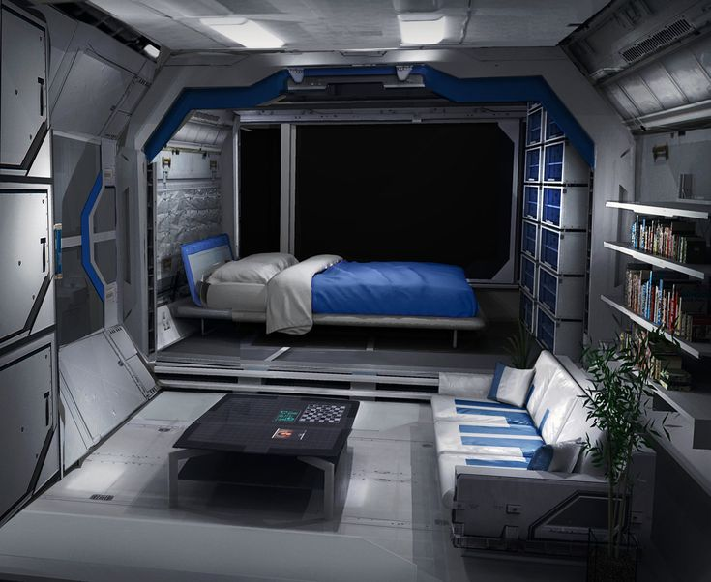
SPACETOPIA: A HOME AWAY FROM HOME

Slide 2
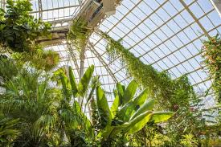
SPACETOPIA: A HOME AWAY FROM HOME
HEADQUARTERS
Every space habitat needs a place where things are organized and put in order. This place is the headquarters, where everything is centralized. Here, the meetings are held. The control panels are also located here.

Slide 3
SPACETOPIA: A HOME AWAY FROM HOME

Slide 4
SPACETOPIA: A HOME AWAY FROM HOME
EARTH RESEARCH CENTRE
Here, we have all sorts of equipment for research about Earth. This section is useful for the times Spacetopia stays on Earth’s orbit. Some example of equipment we have here are GPS trackers, meteorological equipment and telescopes. We, humans, want progress more than anything usually. But, sometimes, we have to pay more attention to our planet, because it is our duty to protect and conserve it.

Slide 5
SPACETOPIA: A HOME AWAY FROM HOME

Slide 6
SPACETOPIA: A HOME AWAY FROM HOME
THE DEPOSIT
The deposit is used for storing food and water. Here, we have all sorts of organic food that helps scientists to stay healthy and energic. A balanced diet is perfect for a long voyage on Earth’s orbit or in space.

Slide 7
SPACETOPIA: A HOME AWAY FROM HOME

Slide 8
SPACETOPIA: A HOME AWAY FROM HOME
THE GYM
The gym is mandatory for a healthy lifestyle in space. Many astronauts have reported different symptoms after staying for a long time in spaceships. For this reason, NASA published a book, where they mention necessary exercises for a fit lifestyle. For example, a crew between 4 and 6 members should exercise daily for 2h, focusing on aerobics and pilates. These exercises make their bodies resistent to the influences in space. The gym also provides a bathroom, with showers.

Slide 9
SPACETOPIA: A HOME AWAY FROM HOME

Slide 10
SPACETOPIA: A HOME AWAY FROM HOME
THE CONSERVATORY
An oasis of relaxation, the conservatory combines the sleeping quarters with a relaxation zone, where scientists can enjoy an artificial zone of nature. Here, oxygen is being collected using the method of electrolysis. It collects the oxygen from water by separating it from hydrogen. It uses the energy from the solar panels and the electromagnetic radar.

Slide 11
SPACETOPIA: A HOME AWAY FROM HOME

Slide 12
SPACETOPIA: A HOME AWAY FROM HOME
MARS RESEARCH CENTRE
The Mars Research Centre is an innovation we created for the famous NASA initiative to make the Red Planet livable. In our hub, scientists can study different rocks and metals from Mars’s structure and surface.

Slide 13
SPACETOPIA: A HOME AWAY FROM HOME

Slide 14
SPACETOPIA: A HOME AWAY FROM HOME
THE RECYCLING ROOM
Here, the trash is deposited in special baskets that are turned into cartridges for 3D printers that immitate different rocks from Mars. It is an easier alternative for studying rare materials.

Slide 15
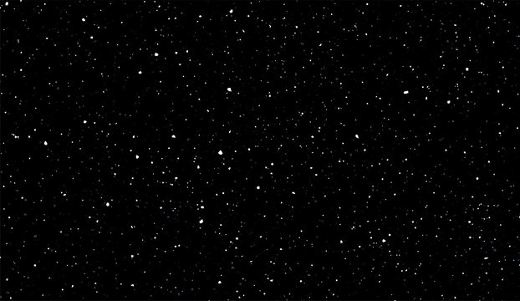
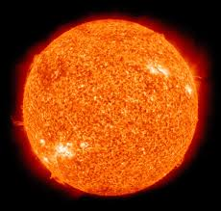
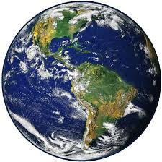

Slide 16
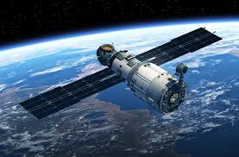

Slide 21
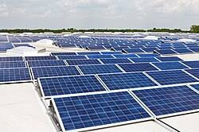
SPACETOPIA: A HOME AWAY FROM HOME
THE ENERGY SOURCE
Spacetopia is powered by solar panels, which are charged during the 3 month faze of the orbitation around the sun, during which the satellite heats up.

Slide 22
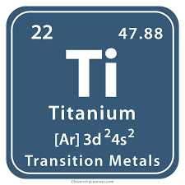
SPACETOPIA: A HOME AWAY FROM HOME
MATERIALS
Because of the high or low temperatures in space, depending on which planet you go to, Spacetopia needs to be made out of a resistant metal, like Titanium. To preserve the atmospheric pressure on Earth, with the value of 101.325 Pascals, a thermos-like mechanism is necesarry. Because of that, the two titanium fibers will have a space with air in between, so that the environment in the satellite won’t exchange with the cosmic environment.

Slide 23

SPACETOPIA: A HOME AWAY FROM HOME

Slide 24
SPACETOPIA: A HOME AWAY FROM HOME
THANK YOU FOR YOUR ATTENTION!
OUR TEAM: YOUNG HACKERS
Stefan Lazarescu
Matei Dumitrescu
Andrei Florica
Ayan Pasol
Stefan Ionescu
Luca Plopsoreanu

